Slide 1
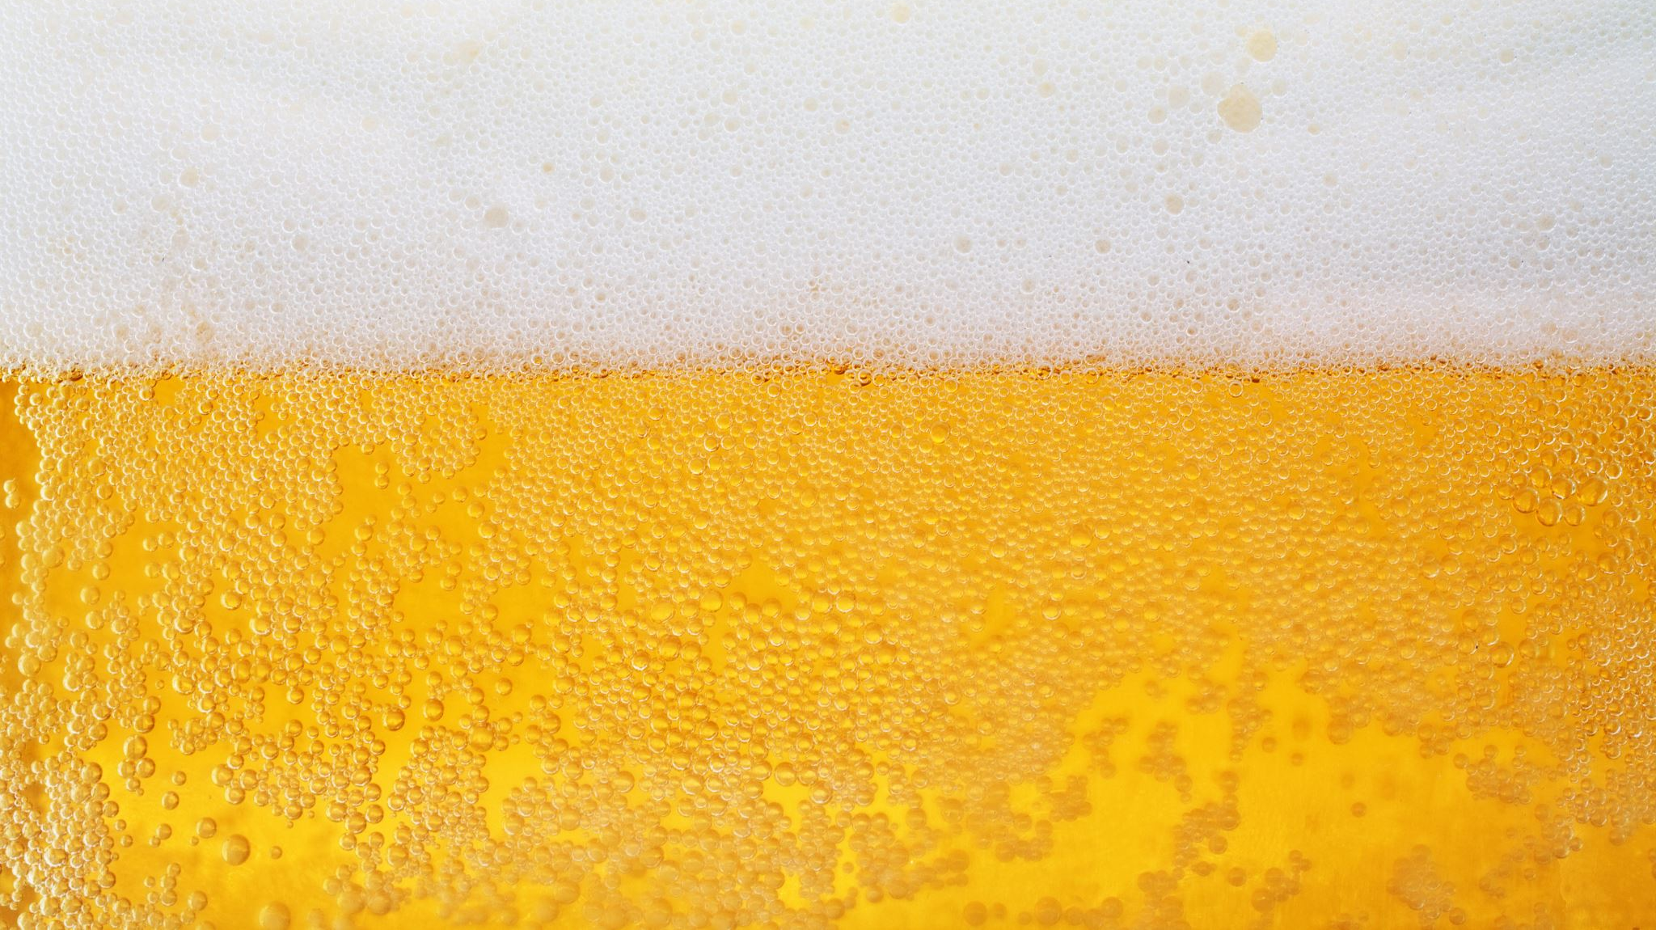
Trends in US Craft Breweries and Beer
Robert Derner

Slide 2
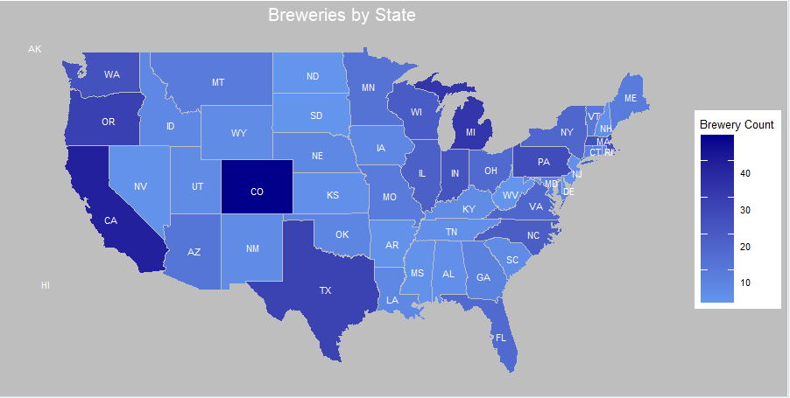
CO = 47 DC = 1
CA = 39 AR = 2
MI = 32 DE = 2
Notes:
CO = 47
CA = 39
MI = 32
OR = 29
TX = 28
PA = 25
MA = 23
WA = 23
IN = 22
WI = 20

Slide 3
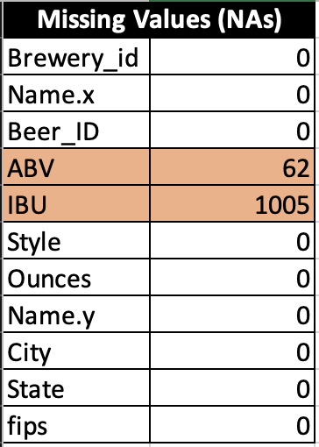
Notes on Missing Data Values
Two Datasets, "Beers.csv" and "Breweries.csv" were joined to create a Full Dataset for analysis and insight
Only ABV and IBU are missing Data Values
Important to note: IBU is missing values in around 42% of the 2,410 total rows of data
**Predictions based upon IBU data specifically, may be skewed
Notes:
CO = 47
CA = 39
MI = 32
OR = 29
TX = 28
PA = 25
MA = 23
WA = 23
IN = 22
WI = 20

Slide 4
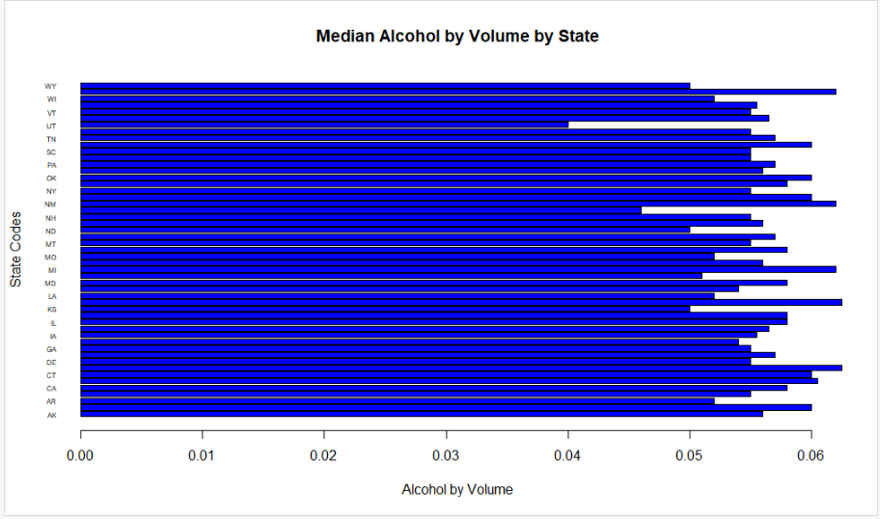
Notes:
Comment about the ABV....Feel fre to delete

Slide 5
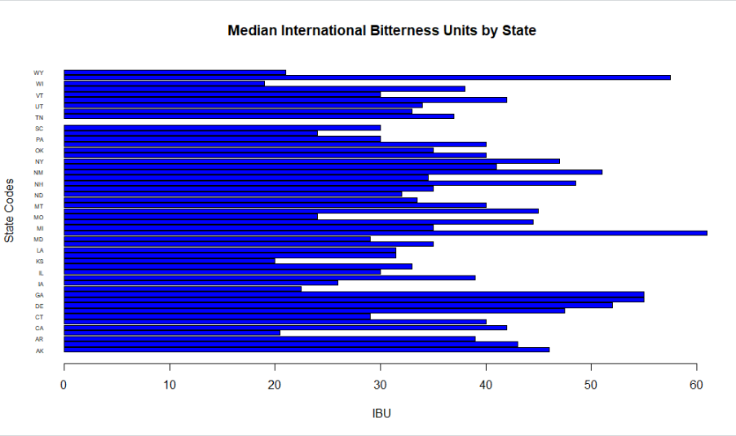
Notes:
Comment about the ABV....Feel fre to delete

Slide 6
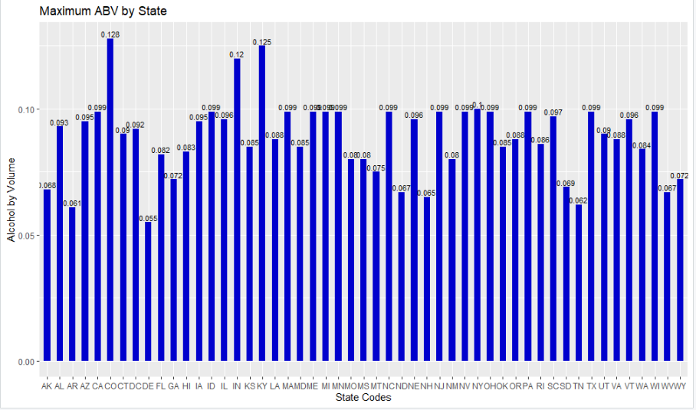
State Superlatives: ABV

Slide 7
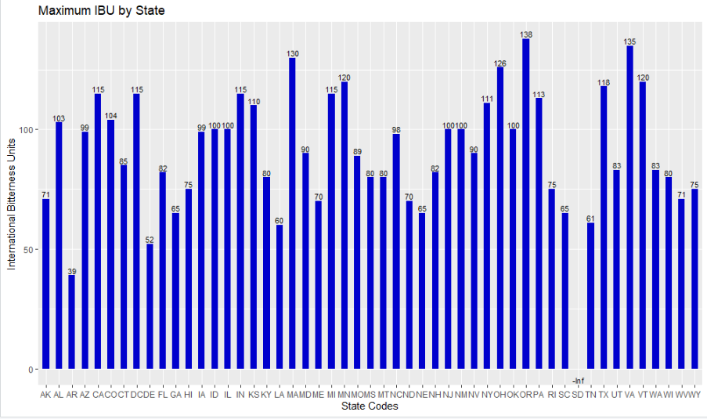
State Superlatives: IBU

Slide 8
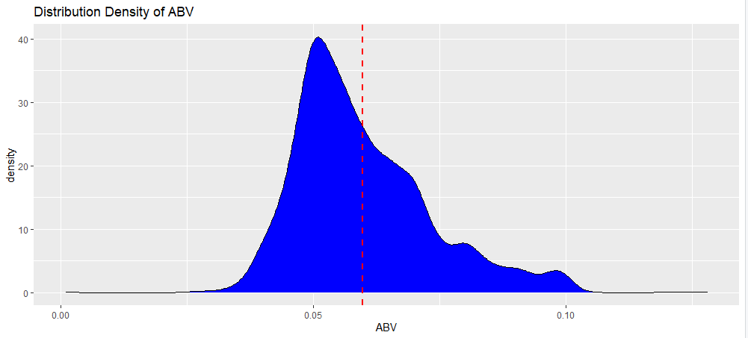
Summary Distribution
Min | 1st Quartile | Median | Mean | 3rd Quartile | Max | NA's
0.00100 | 0.05000 | 0.05600 | 0.05977 | 0.06700 | 0.12800 | 62
Notes:
Summary(Beer_Merge$ABV)
Beer_Merge %>%
ggplot(aes(x = ABV)) + geom_density(binwidth = .5, colour="black",fill="blue") +
geom_vline(aes(xintercept=mean(ABV, na.rm=T)),
color = "red", linetype = "dashed", size = 1) +
ggtitle("Distribution Density of ABV")
Very few nulls out of 2410 observations
The data can be interrupted that the distribution is skewed but definably leans towards the center with more values falling left of mean.

Slide 9
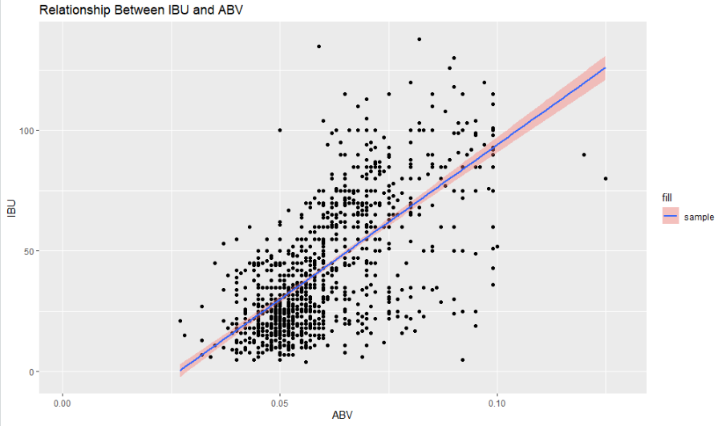
Bitterness & ABV
Notes:
Beer_Merge %>%
ggplot(aes(x = ABV, y = IBU)) + geom_point() + geom_smooth(method = lm) + ggtitle("Bitterness by ABV")
Even with a sample of 1005 beers out of 2410 observations in total of IBU, we can conclude that a p value of 2.2e-16 we can say, we should reject the null hypothesis given an intercept of 0, which is further proved by the confidence interval being .64 to .69 at alpha of .05 or 95%.
There appears to be a strong relationship with a r-squared correlation of .6706 squared.
It's a fair to state that when the ABV or IBU is increased the other shall also increase.

Slide 10
Thank You!
Q&A
rderner@smu.edu
(213)-632-6305
Notes:
Beer_Merge %>%
ggplot(aes(x = ABV, y = IBU)) + geom_point() + geom_smooth(method = lm) + ggtitle("Bitterness by ABV")
Even with a sample of 1005 beers out of 2410 observations in total of IBU, we can conclude that a p value of 2.2e-16 we can say, we should reject the null hypothesis given an intercept of 0, which is further proved by the confidence interval being .64 to .69 at alpha of .05 or 95%.
There appears to be a strong relationship with a r-squared correlation of .6706 squared.
It's a fair to state that when the ABV or IBU is increased the other shall also increase.

Slide 11
#8) Budweiser would also like to investigate the difference with respect to IBU and ABV between IPAs (India Pale Ales) and other types of Ale (any beer with “Ale” in its name other than IPA).
## You decide to use KNN classification to investigate this relationship.
## Provide statistical evidence one way or the other. You can of course assume your audience is comfortable with percentages … KNN is very easy to understand conceptually.
#filter for nulls
Beer_no_nulls = Beer_Merge %>%
filter(!is.na(ABV) & !is.na(IBU))
#Filter down datasets
grep("Ale",Beer_no_nulls$Style) #211
Ale <- filter(Beer_no_nulls, grepl("Ale",Style))
IPA <- filter(Beer_no_nulls, grepl("IPA",Style))
#merge them back together
names(Ale)[2] <- 'Beer_Name'
names(IPA)[2] <- 'Beer_Name'
names(Ale)[8] <- 'Brewery_Name'
names(IPA)[8] <- 'Brewery_Name'
Beer_ALE_IPA <- rbind(Ale, IPA) #appending all records together and merging the data wihtout changing column because they are the same
#train/test/split
set.seed(117)
splitPerc = .70
trainInd = sample(seq(1,dim(Beer_ALE_IPA)[1],1),round(.7*dim(Beer_ALE_IPA)[1]))
train = Beer_ALE_IPA[trainIndices,]
test = Beer_ALE_IPA[-trainIndices,]
Beer_ALE_IPA %>% ggplot(aes(x = ABV, IBU, color = State)) + geom_point()
# Attempt 1: k = 3
classifications = knn(IPA_ALE_Train[,c(4,5)],IPA_ALE_Test[,c(4,5)],IPA_ALE_Train$ABV, prob = TRUE, k = 3)
classifications
table(classifications,IPA_ALE_Test$ABV)
#error in !all.equal(nrow(data), ncol(data)): invalid argument type
confusionMatrix(table(classifications,IPA_ALE_Test$ABV))
#Attempt 2: Confusion Matrix
model = naiveBayes(IPA_ALE_Train[,c(4,5)],IPA_ALE_Train$ABV)
table(predict(model,IPA_ALE_Test[,c(4,5)]),IPA_ALE_Test$ABV)
#error in !all.equal(nrow(data), ncol(data)): invalid argument type
CM = confusionMatrix(table(predict(model,IPA_ALE_Test[,c(4,5)]),IPA_ALE_Test$ABV))
CM
Notes:
Even with a sample of 1005 beers out of 2410 observations in total of IBU, we can conclude that a p value of 2.2e-16 we can say, we should reject the null hypothesis given an intercept of 0, which is further proved by the confidence interval being .56 to .75 at alpha of .05 or 95%.
There appears to be a strong relationship with a r-squared correlation of .6706 squared.
It's a fair to state that when the ABV or IBU is increased the other shall also increase.

Slide 12
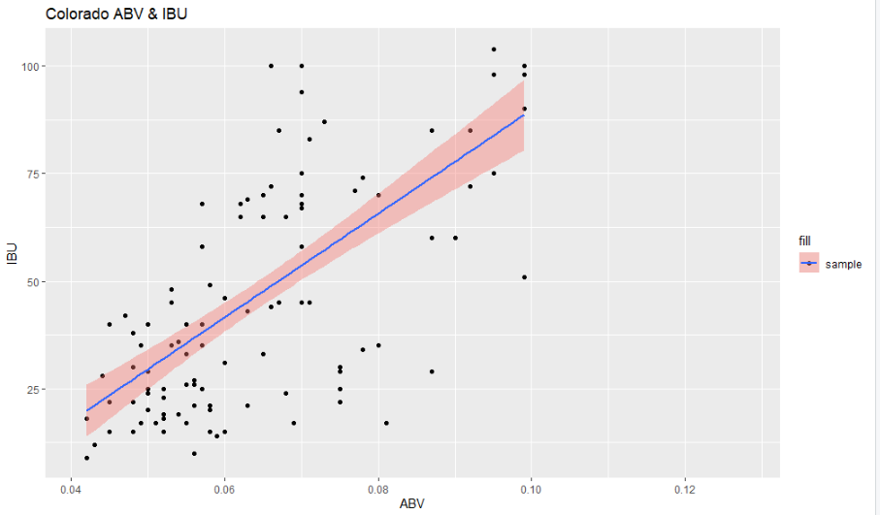
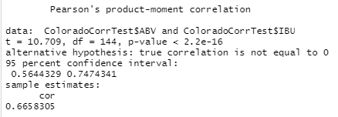
Colorado Bitterness & ABV
Notes:
Even with a sample of 1005 beers out of 2410 observations in total of IBU, we can conclude that a p value of 2.2e-16 we can say, we should reject the null hypothesis given an intercept of 0, which is further proved by the confidence interval being .56 to .75 at alpha of .05 or 95%.
There appears to be a strong relationship with a r-squared correlation of .6706 squared.
It's a fair to state that when the ABV or IBU is increased the other shall also increase.

